Slide 1
Incomer Careers
Recent Immigrants × Job Search
David Randall • Raymond Luong • Kathryn Rivard • Eric Dudiak

Slide 2


Sumit attends a job fair
uwgbadmissions/5036677700

Slide 3
Sumit attends a job fair
What line should I stand in?
Where do I want to work?
Who hires internationals?
What should I ask the recruiter?

Slide 4

Sumit attends a job fair

Slide 5

Sumit attends a job fair

Slide 6


Slide 7
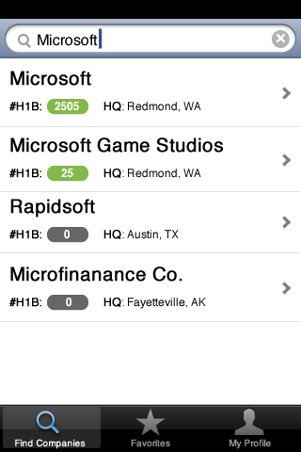
Incomer Careers: Job Fair Assistant
Sumit uses the search tool to make a list of companies at the fair he’s interested in.

Slide 8
More About Sumit
Software Engineer
Professional career
Imminent graduate of a U.S. Master’s program
Access to career fairs and campus recruitment events
Citizenship is an issue
Wants to live here permanently
Long-term visa and Green Card interest

Slide 9

Consider Jing
Physician
Professional career
Complex requirements
Husband is moving to US for work; she’s researching hospitals nearby
Work visa still an issue
Wants to live here permanently
Long-term visa and Green Card interest

Slide 10
Up Next
Persona introduction and list-building scenario
Persona breakdown and target user group
Immigration challenges for professionals
Discarded scenario: Document Management
Back to Sumit: Queueing scenario
Opportunities

Slide 11
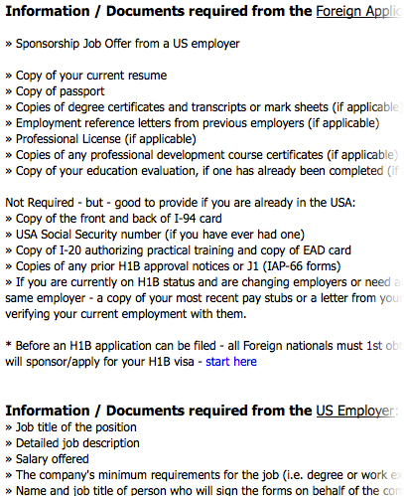
Challenges for professionals like Sumit and Jing
Work visa
Transfer of credentials
“…forget Canada. If I want to practice medicine in West Virginia and Ohio, I need to get licensed (and get insurance coverage) in both of those states in addition to Pennsylvania. …To give you an idea of the depth of that hierarchy of credentials, when I returned to medical practice in 2008 (after a two-year hiatus) my application to reactivate my medical license was (with supporting documents) 243 pages long.”

Slide 12
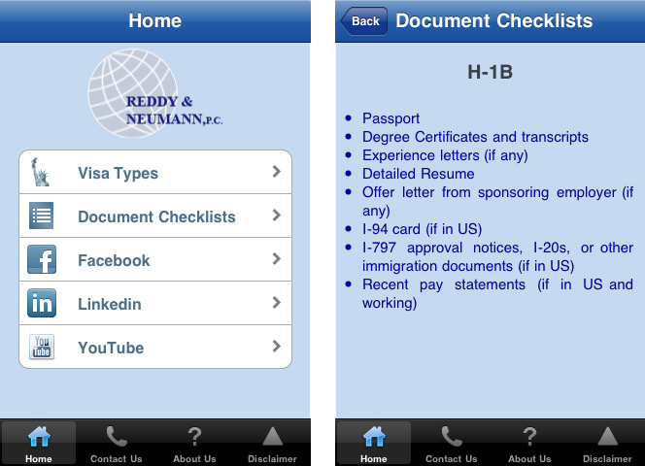
iStayLegal

Slide 13
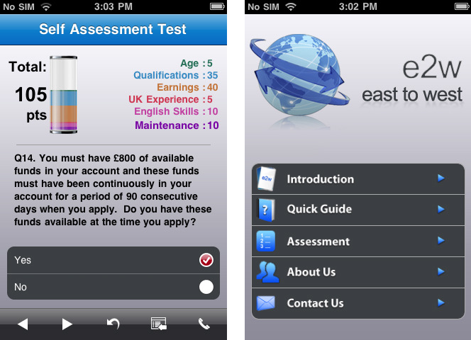
e2w – East To West

Slide 14
Our Assumption:
Document management should be an important part of our app

Slide 15
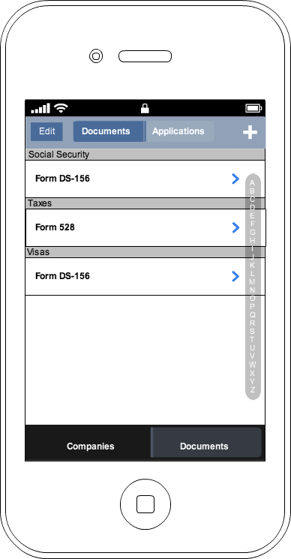
Document Library

Slide 16
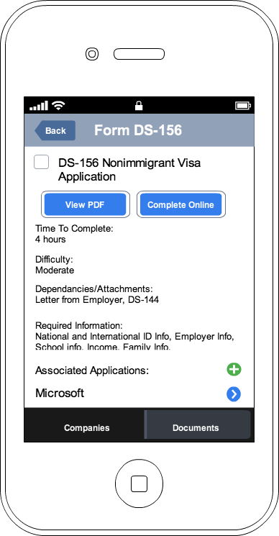
Document Library

Slide 17
Discarding the Document Library
Typically, employers prioritize skill set; if you’re talented, we’ll take you and worry about documentation later.
If students need advice on legal documents (e.g. how to remain in U.S. legally), they are referred to the Office of International Education.
Kevin Collins, CMU Career Center

Slide 18
Discarding the Document Library
Credentialing is a major hassle, so much so that recruiting agencies and hospitals generally have to help physicians through the various state bureaucracies. … When I'm applying for a job, they'll just ask me to provide them with lists of documents, which I send to them, and let them handle the details.
Randy Peters, Physician

Slide 19
Focus on Reconnaissance
Career Fairs
On-the-go research

Slide 20
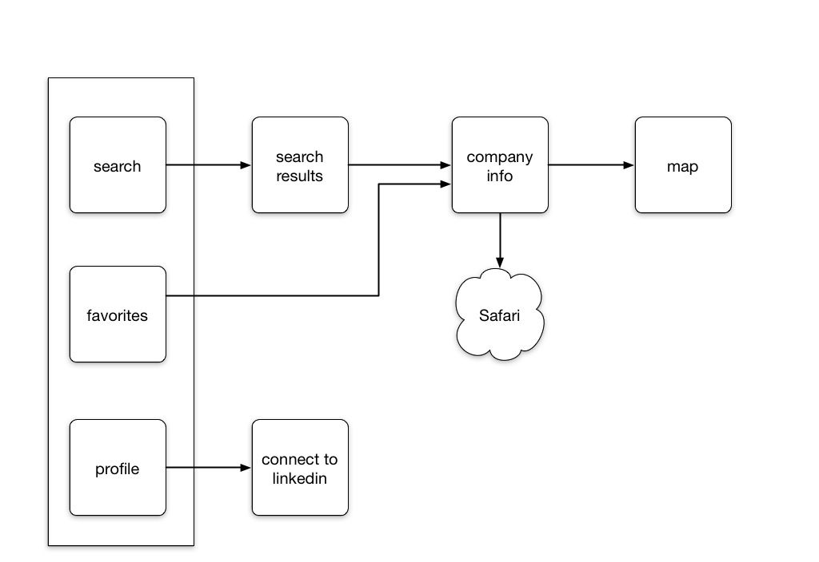
Extended Demo

Slide 22
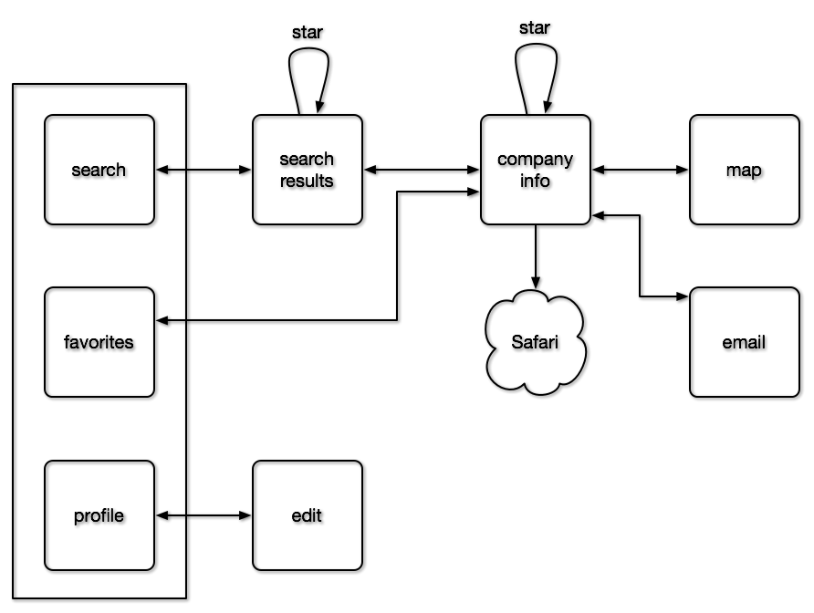

Slide 23
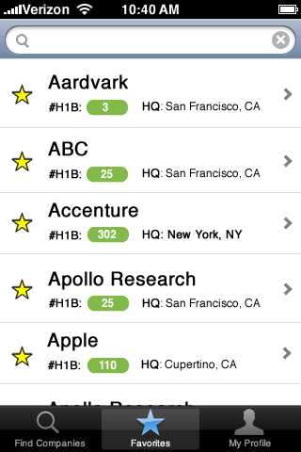
Incomer Careers: Job Fair Assistant
Notes:
Sumit reviews his favorites list as he looks over the event hall.
He quickly views basic international statistics, and goes to the booth for a company with an excellent history of helping new hires with their visas.

Slide 24
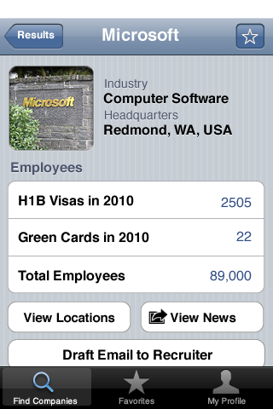
Incomer Careers: Job Fair Assistant

Slide 25
Incomer Careers: Job Fair Assistant
Notes:
Drilling down to see detailed information, he thinks of several questions to ask the recruiter.

Slide 26
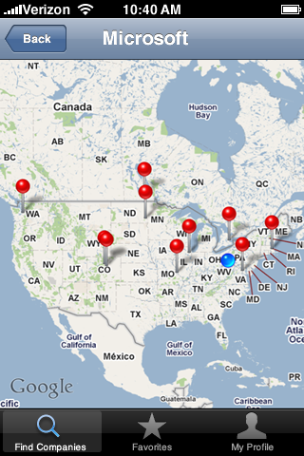
Incomer Careers: Job Fair Assistant
Notes:
Drilling down to see detailed information, he thinks of several questions to ask the recruiter.

Slide 27

Incomer Careers: Job Fair Assistant
Notes:
Man, this is a long line.
Sumit clicks around on the interface a bit and finds the “News” button, which pops him out into a browser search for this company.

Slide 28
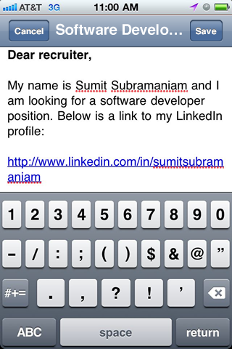
Incomer Careers: Job Fair Assistant
Notes:
After talking with the recruiter, sumit touches “draft email” to send a copy of his resume. Since there are more people he wants to talk to, he saves the email so that he can write a proper cover letter later.

Slide 29
Going Forward
Easy opportunities for company involvement
HR control over company info
Ads and visibility
Location-aware devices could personalize the experience for both companies and job-seekers

Slide 30
Supporting Evidence
Interviews: CMU Career Center, Career Fair jobseeker, Physician, Epic HR (medical software company), Amandeep (software developer from India), Jeeyun (software developer from Korea)
Software review: iStayLegal, e2w, Symplicity (Tartan Trak)
Services review: CMU Career Fair flags, skeezy “immigration kit” websites
Policy review: US immigration policy, temporary work visas, permanent residence, citizenship applications

